Slide 1
Home Credit Default Risk
By/ Ali Nasser

Slide 2
TABLE OF CONTENTS
01
02
03
EDA
Modeling and Deployment
PROBLEM & Data set
Dataset and problem overview
Try finding the feature's that affect target the most
Build machine learning model to predict target and model Deployment

Slide 3
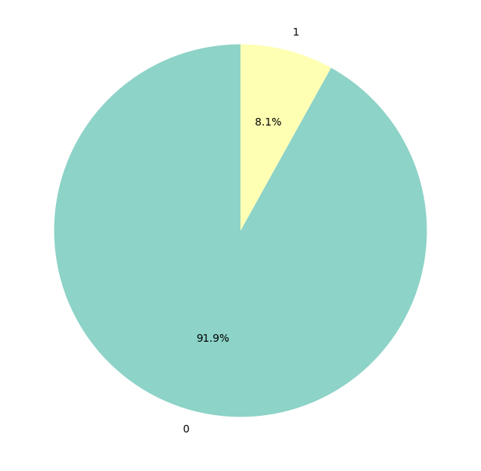
PROBLEM & Data set
Predict if each applicant is capable of repaying loan or not
Negative - 0 :Able to repay a loan
Positive -1 :Unable to repay a loan

Slide 4
EDA
Load and clean Data
Data Analysis
Feature Engineering
Data Transformation

Slide 5

Modeling and Deployment
Xgboost was the best performing model
- Streamlet was used to create dashboard for model Deployment

Slide 6
Thank you

